Slide 1
ESGF Scientific Contributions to Geoscience Research Communities
Task |  | R&D Area
1.1 |  | Data Management
1.2 |  | User Interface and Search
1.3 |  | Hardware & Network
1.4 |  | Data Transfer
1.5 |  | Installation (Containerized)
1.6 |  | Authentication & Authorization
1.7 |  | Federation
1.8 |  | Quality Control & Assurance
1.9 |  | Replication
1.10 |  | Distributed Search
1.11 |  | Metrics
1.12 |  | User Notification
1.13 |  | Long-tail Publication
1.14 |  | Distributed Computation
1.15 |  | Data Citation
2.1 |  | Provenance Capture
2.2 |  | Workflow
2.3 |  | Dynamic Resources
2.4 |  | In situ Analysis
2.5 |  | Machine Learning
2.6 |  | UQ
2.7 |  | Analytical Modeling
2.8 |  | Mobile Apps
Current capability status:
 | Usable
 | Prototype
 | Research activity
LLNL-PRES-732381
Ji-Woo Lee, Ph.D.
Lawrence Livermore National Laboratory
2017 Triennial Project Review, Potomac, MD
June 8 – 9, 2017
This work performed under the auspices of the U.S. Department of Energy by Lawrence Livermore National Laboratory under Contract DE-AC52-07NA27344
Notes:
Hello everyone, thank you for attending this presentation. What I am going to present is about how ESGF would make scientific contribution to geoscience research communities. It partially covers highlighted tasks from the R&D areas listed in the proposal, which are …

Slide 2















ESGF software system and science integration
Operations
Geoscience research integration
Uncertainty Quantification
Community Machine Learning
Knowledge discovery
In situ analysis
Cloud technology
Visualization
Exploratory analysis
Analytical Modeling
Uncertainty
Quantification
Distributed
Computing
Community
Machine
Learning
Provenance
Capture
Long-tail
Publication
CDMS
Cloud
CMOR
Analytical
Modeling
CF
In situ
Analysis
Metrics
Research
Development
Notes:
This slide, which I grabbed from Dean’s presentation, is showing ESGF software system and science integration.
My works are mostly related to the research side, specifically for those three parts:
Geoscience research integration
Visualization
And Exploratory analysis

Slide 3
Purpose
Provide advanced tools for distributed big data analysis and visualization
Integrate into ESGF examples of complex but established analysis routines that can expedite research in diverse geoscience communities
Emphasize (but not limited to) capabilities designed for BER’s mission and projects (for example, CMIP, ACME, and PCMDI)
Notes:
Specified purposes are…

Slide 4
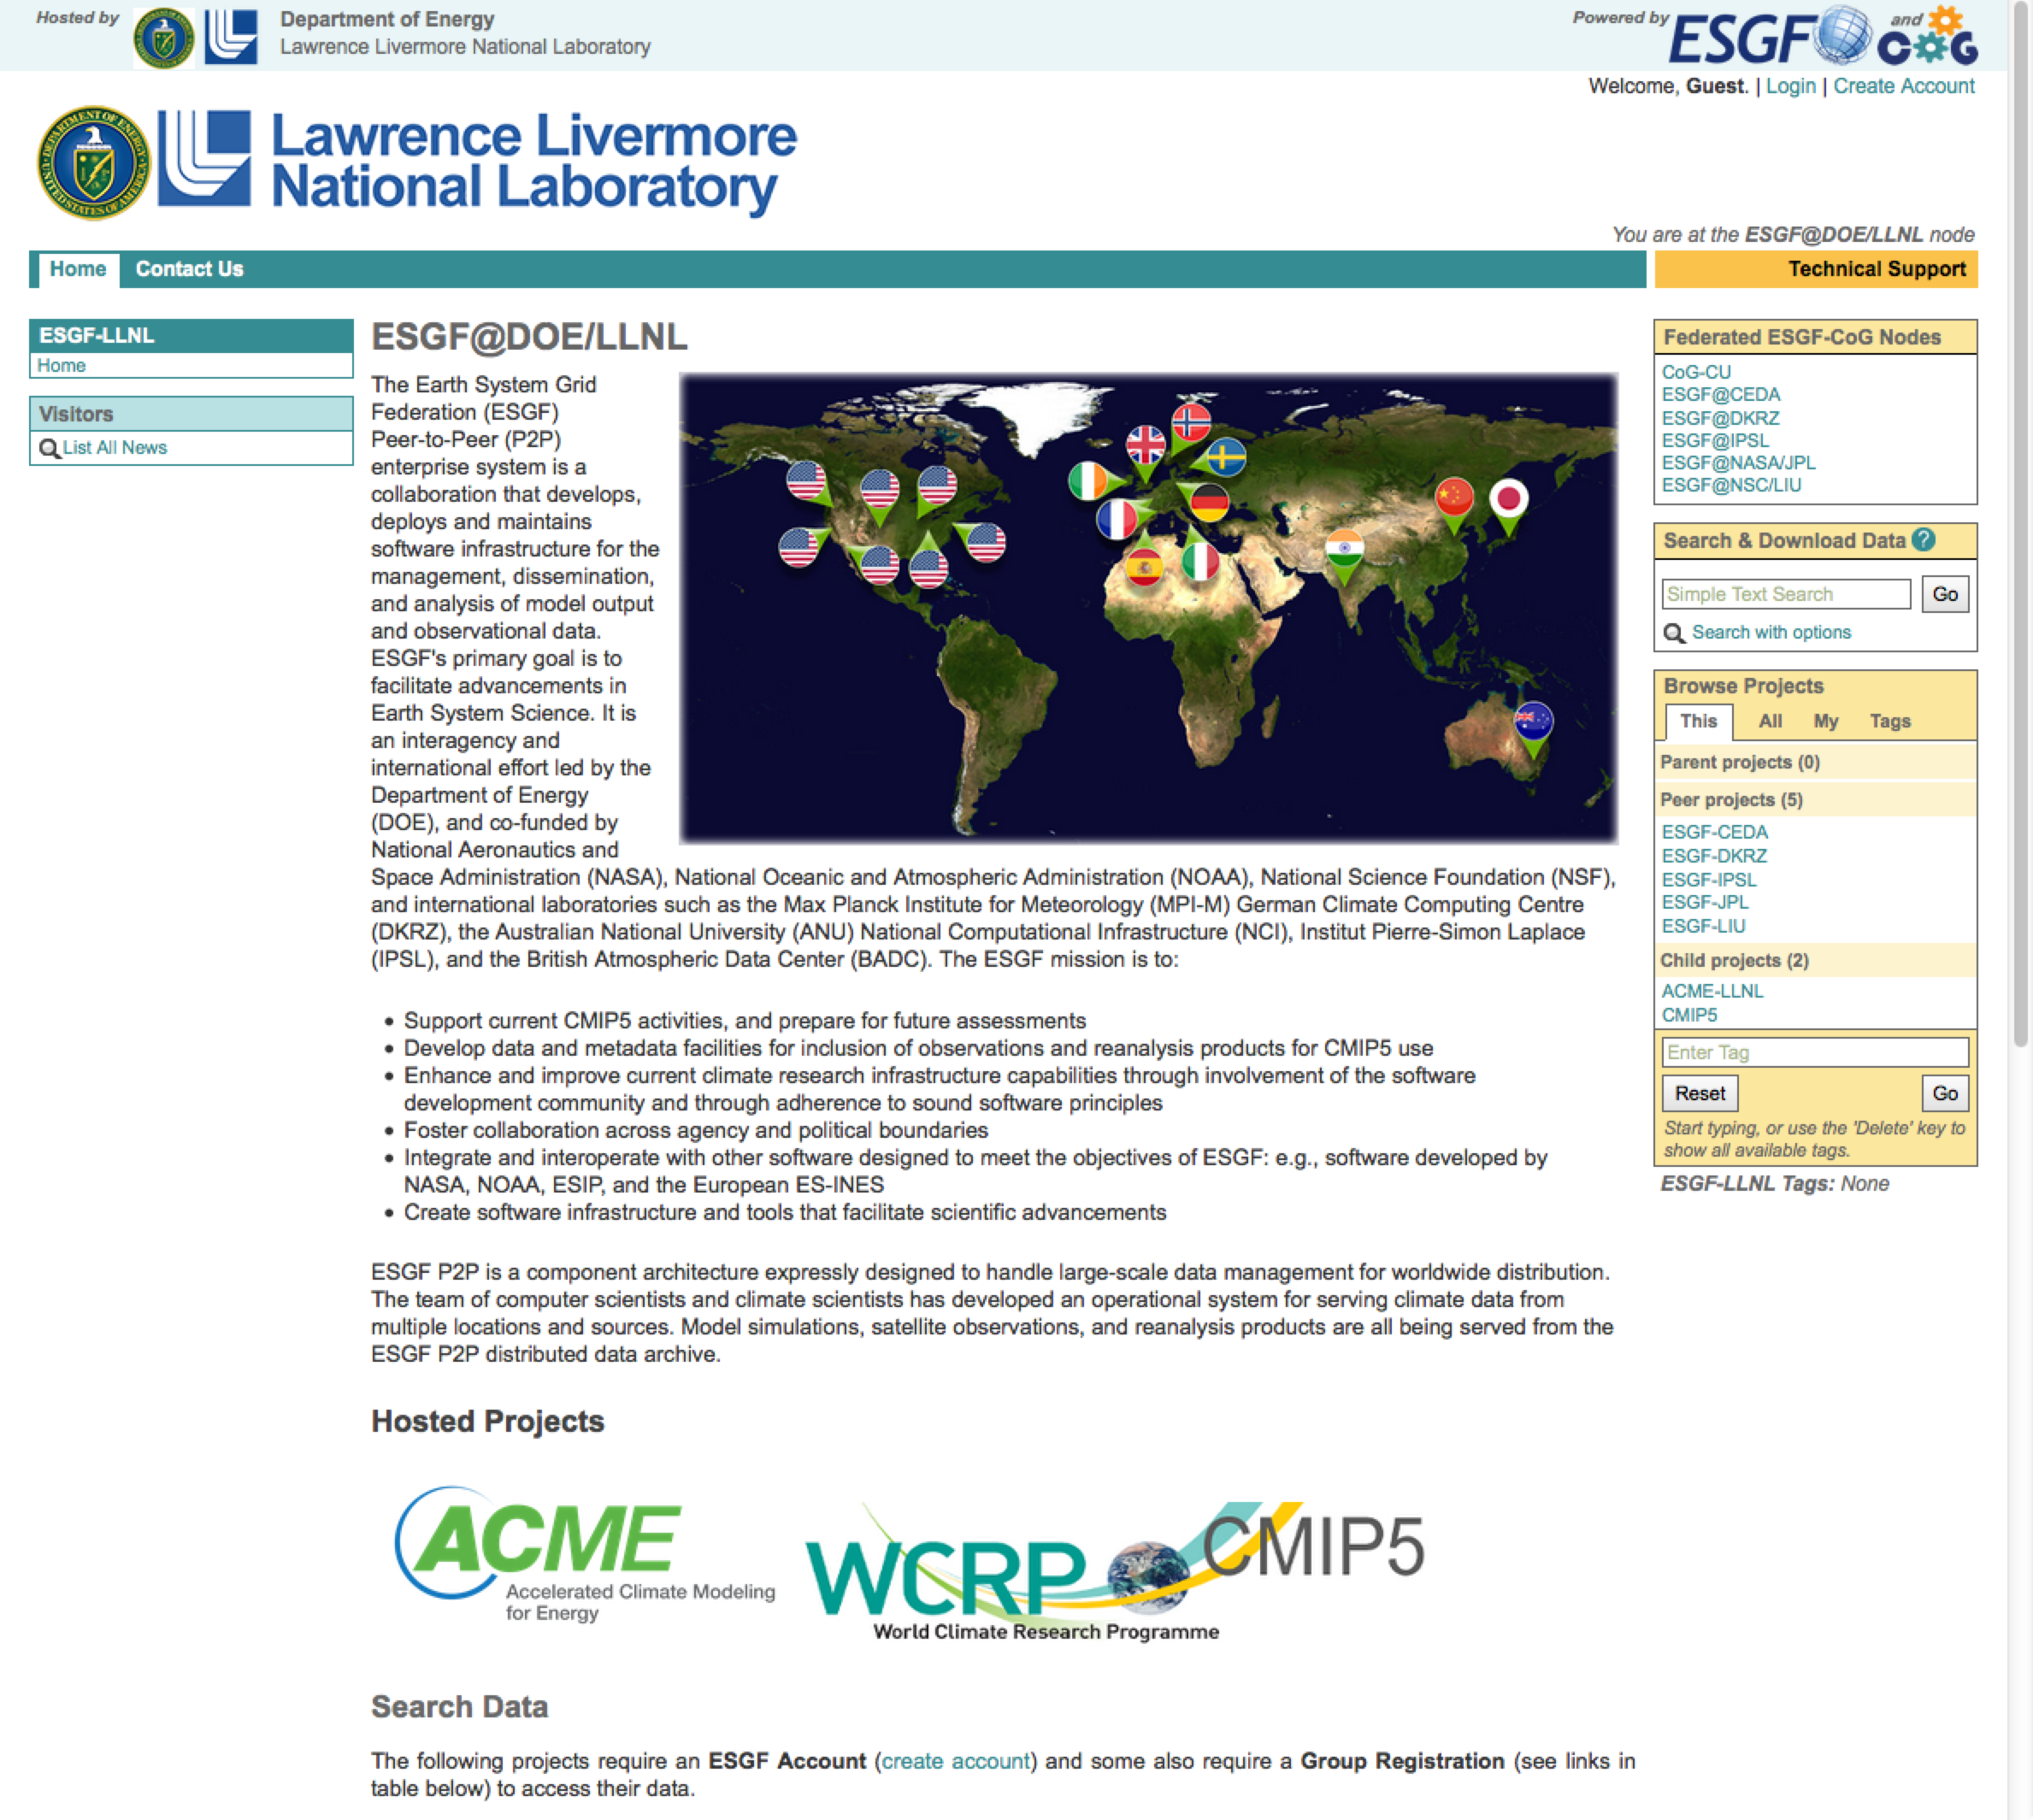
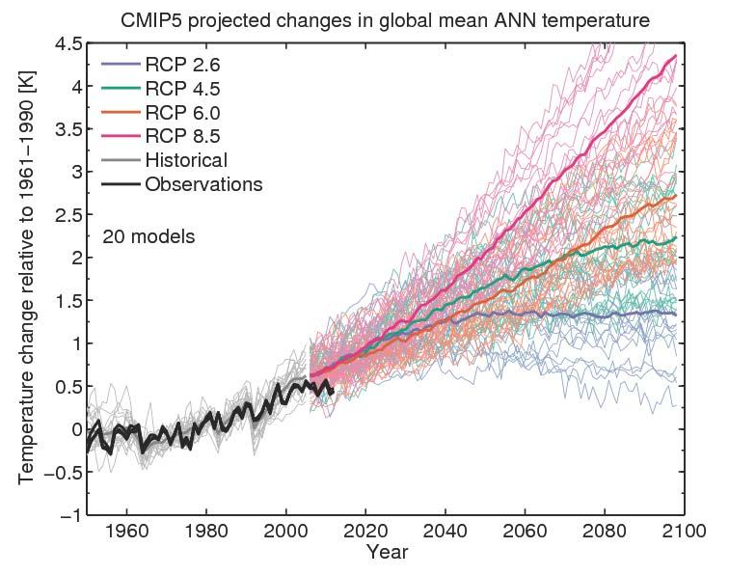
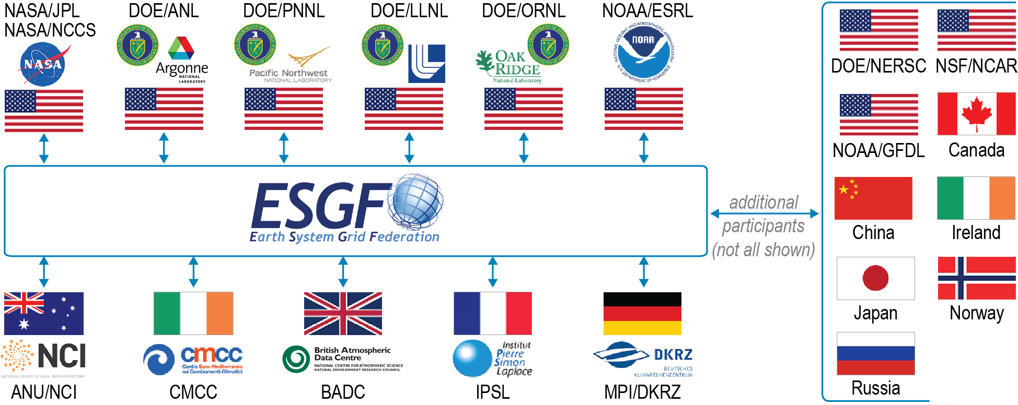
Metrics for Model Evaluation (1)
Coupled Model Intercomparison Project (CMIP)
ESGF
Hawkins and Sutton (2009)
ESGF data nodes and its web access
Future projections simulated by CMIP participating models
Notes:
One of major datasets that is distributed through the ESGF node is output from CMIP, the Coupled Model Intercomparison Project. The project collects petabyte scale of climate simulation.
One of the main issues here is to measure the skill of individual models and to identify model uncertainty. There is spread of line which indicate uncertainty in the future climate prediction. To have better idea, research communities have developed various metrics for the model evaluation.

Slide 5
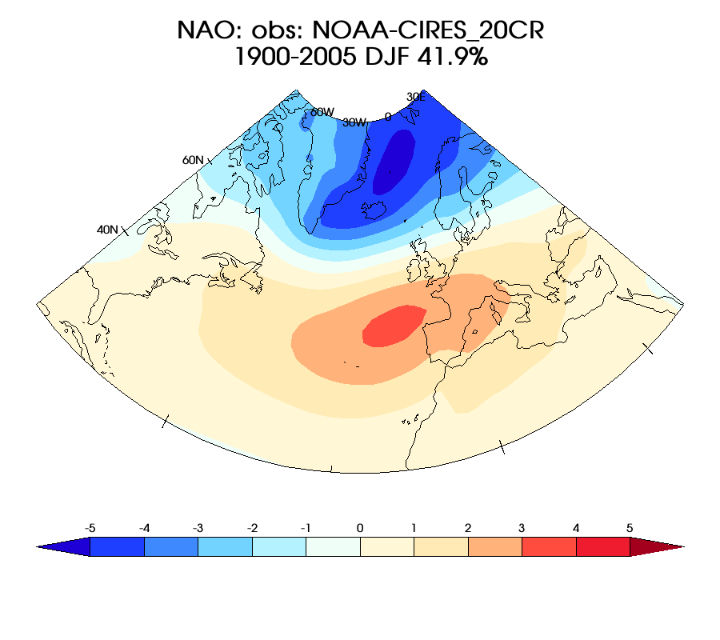
Metrics for Model Evaluation (2)
Interrogating models with observations
Modes * Seasons * Models * Their ensemble members * Metrics .. ~ 10⁴ images and statistics!
Notes:
For example, let’s say you want to measure skill for how model captures specific atmospheric phenomena, whatever it is.
This spatial map is from the observation, and you will derive same maps from individual climate models. And let’s say you want to check multiple phenomenon, in each season, and you want to check all ensemble members separately. Multiplying those factors, at the end, you will get more than 10 thousand images and statistics.

Slide 6
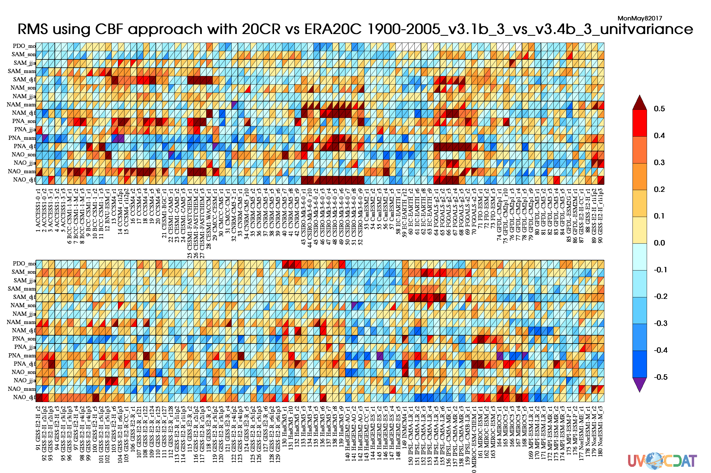
Metrics for Model Evaluation (3)
Goal: Enable user to apply new metrics and/or simulations across federation
Different aspects
Model Evaluation Metrics
(Unit variance EOF pattern)
Worse
ESGF
Multiple metrics / variables / seasons / etc.
Median
Better
All available (or user selected) models / datasets
User’s model
Summarizes ~ 3K statistics in one plot
Notes:
By running through the metrics, you will get something like this plot, which is showing relative model performance for different aspects in one view.
Technically you can do this on your local machine, if you completely downloaded all the data that required. But you will realize that downloading all the model and build database structure in your local side are huge amount of works.
We propose building this kind of comprehensive metrics from ESGF server-side. Combining with CDP that Zeashawn presented, this will allow users to upload their own metrics, and run it on the cloud of ESGF. You don’t need to download individual model output, you don’t need to build your own database structure, nor you don’t need to maintain your local storage system.
This functionality will accelerate application of metrics to entire model data archived in the ESGF nodes, which would open doors for very active model evaluations in various aspects. That must lead community to have better climate model in the future.

Slide 7
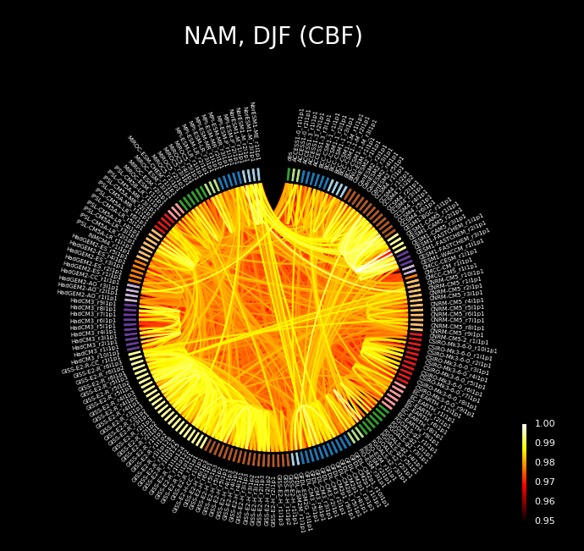
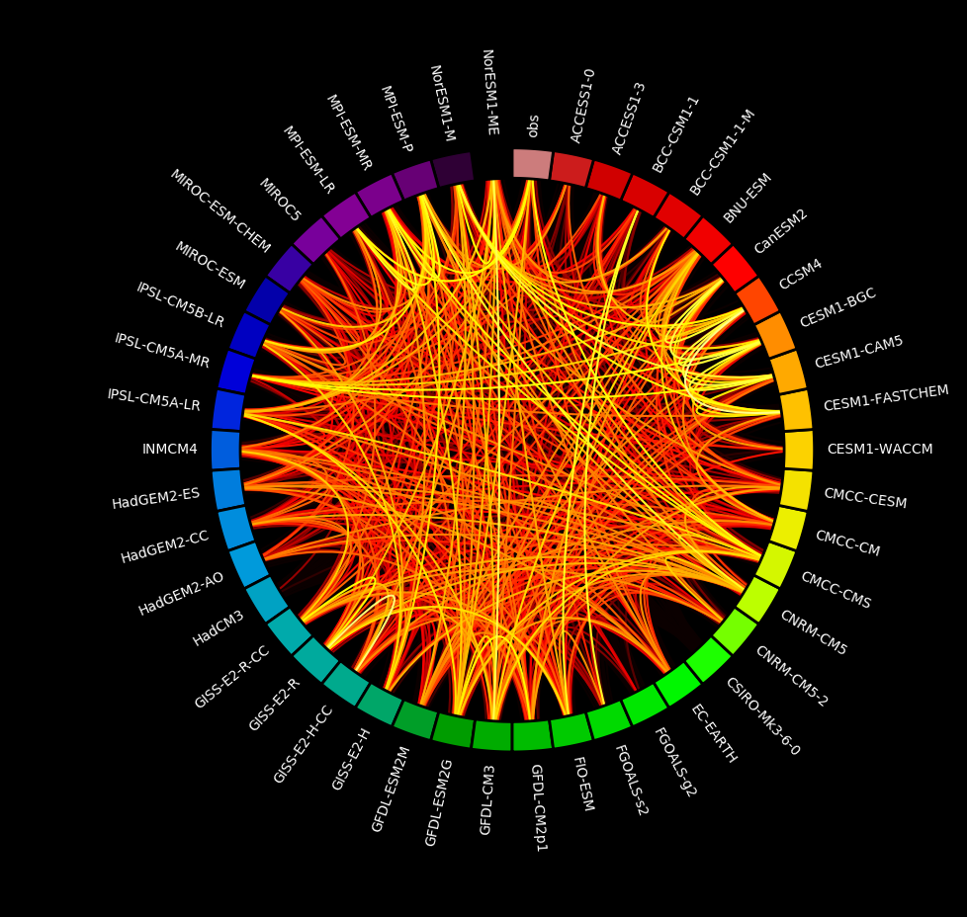
Metrics for Model Evaluation (4)
Dependency between models (Prototype)
Developing alternative way of big-data visualization for simulation performance and dependency testing
Example plot enables identifying dependency between models
Originally designed for bio-medical applications to identify connectivity between genes or cells
Summarizes relationship between more than 30K statistics in one plot
Notes:
Plot from the previous slides summarize 3K statistics in one plot by comapring observation to individual models.
Another statistics that community has been interested is comparing not only observation to model, but also comparing individual model to model, to see how models have connectivity to others.
The plot I am showing here is completely new type of plot in the geoscience field.
It identifies dependency between models, bright connection indicate they are highly correlated.
It is originally designed for bio-medical applications to identify connectivity between genes or cells.
The great advantage of this plot is that it summarizes more than 30 thousand statistics in one view.
In the prototype plot they are highly dominated by different ensemble members of same model, so let me simplify this by showing one simulation per one model. It is interesting to see that some models are dependent to others, and I guess that is because they are sharing some of model components, which could be atmospheric model, ocean model, land surface model, or physical parameterizations.
Having this plot from server-side calculation would certainly accelerate advances in model genealogy researches, which is one of recently growing new fields in the climate science.
I am propose advancing visualization for performance appraisal …..
Circular plot…
It ends up with more than 50K images and statistics, which means they cannot be summarized by conventional plots that has been used.
Prototype.....

Slide 8

Scientific analysis examples (1)
CDAT is advanced and efficiently handle-able analysis tool
A foundation of robust tutorials and examples to enable rapid prototyping and development
Enable CDAT capabilities in geosciences, beyond BER
Notes:
One other major effort is helping community to have advanced analysis tool. Here we are building examples for frequently conducted scientific analysis using CDAT.
CDAT is ….
We propose to provide “A foundation of ....”
We

Slide 9
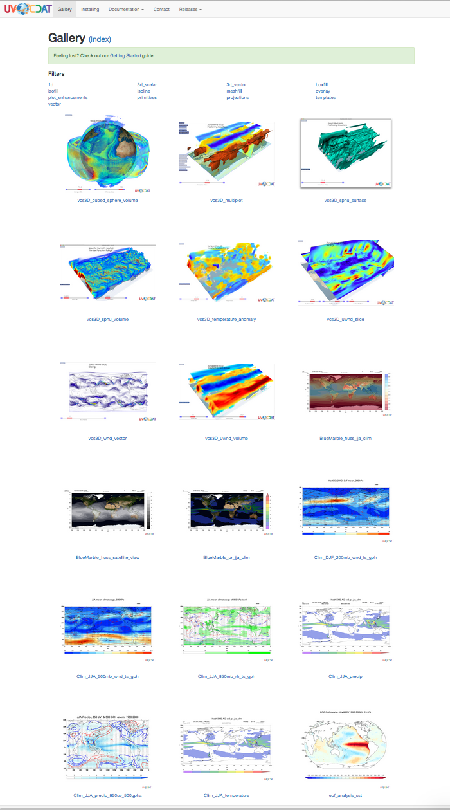
Scientific analysis examples (2)
Examples of frequently repeated analyses:
Seasonal climatology / anomaly
EOF analysis
Running average
Hovmoller & Taylor Diagram
Multi-model ensemble
Etc
https://uvcdat.llnl.gov/gallery.html
Notes:
There are some analyses that very frequently repeated from research communities, such as: …..
As an effort of helping the community, I have built scientific visualization examples for those analyses and they have been displayed on the UVCDAT website.
Users can click interested plot than the website provides description and Python code for creating that plot.
We will be adding more examples as further work.

Slide 10
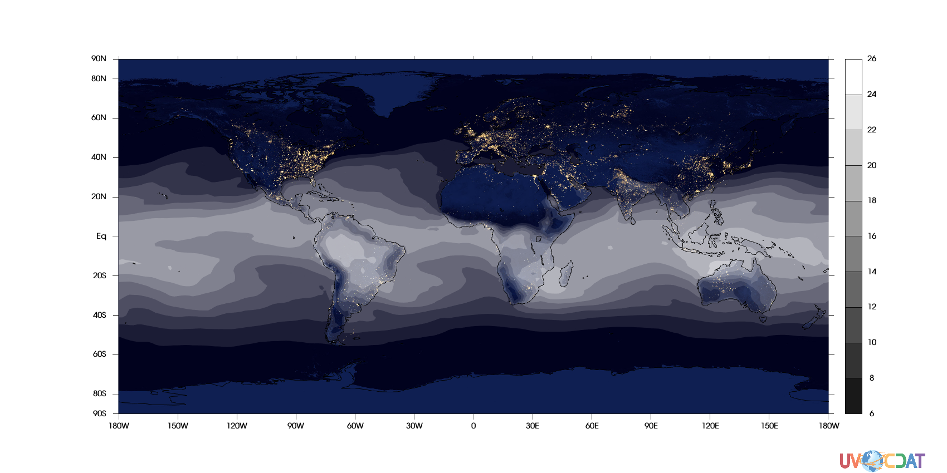
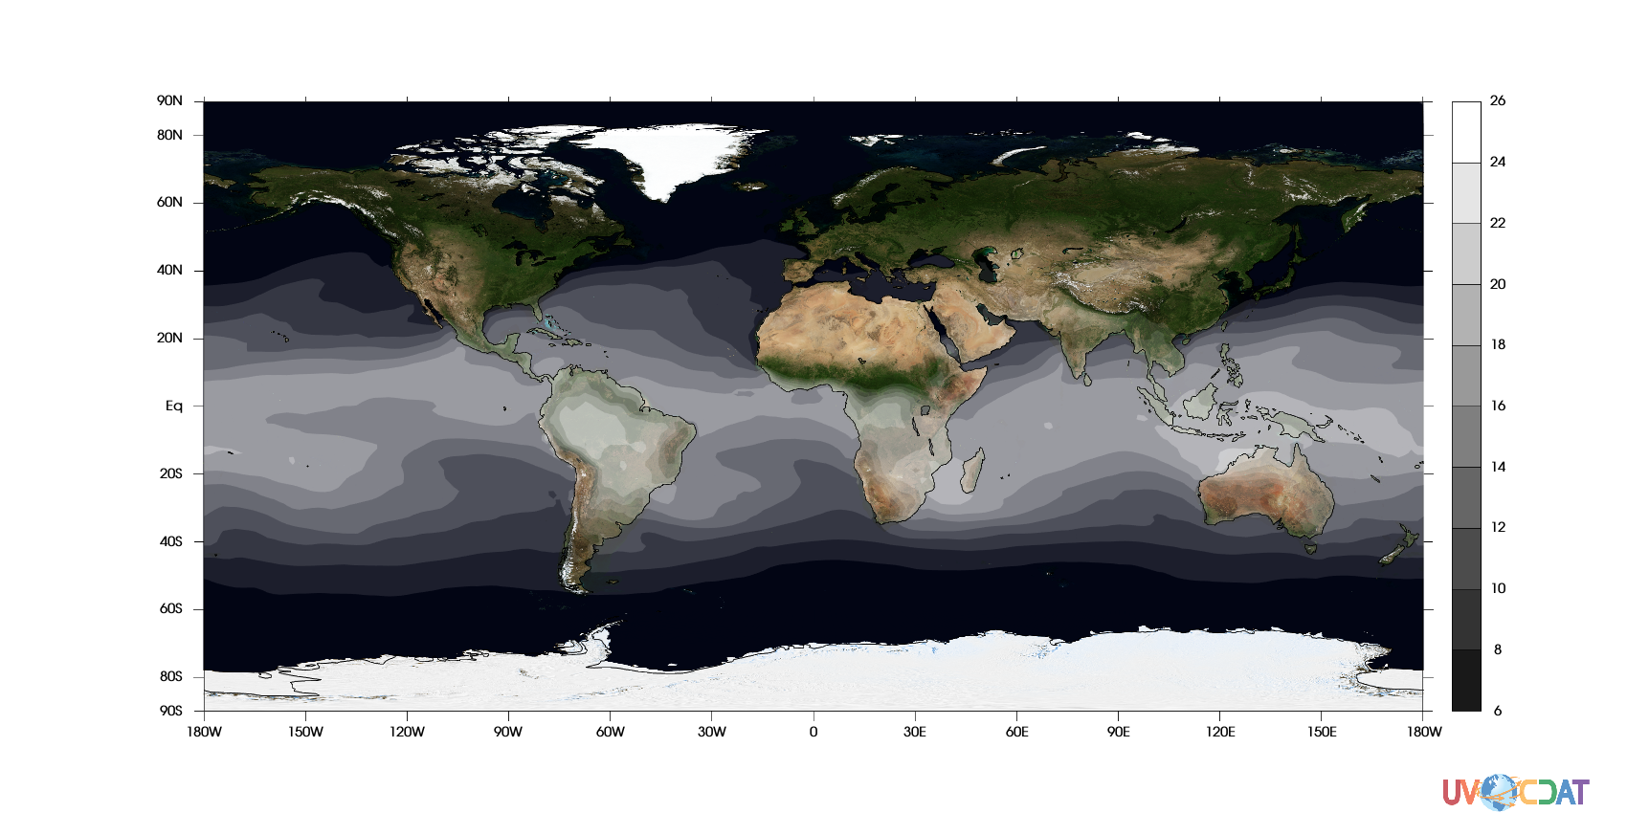
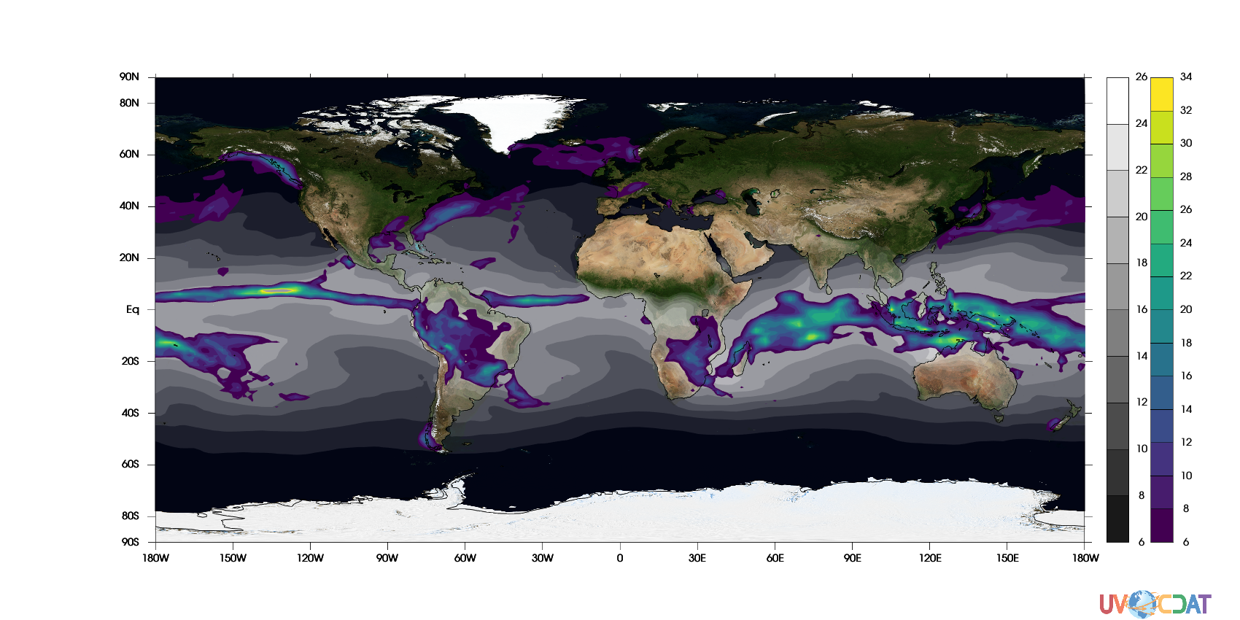
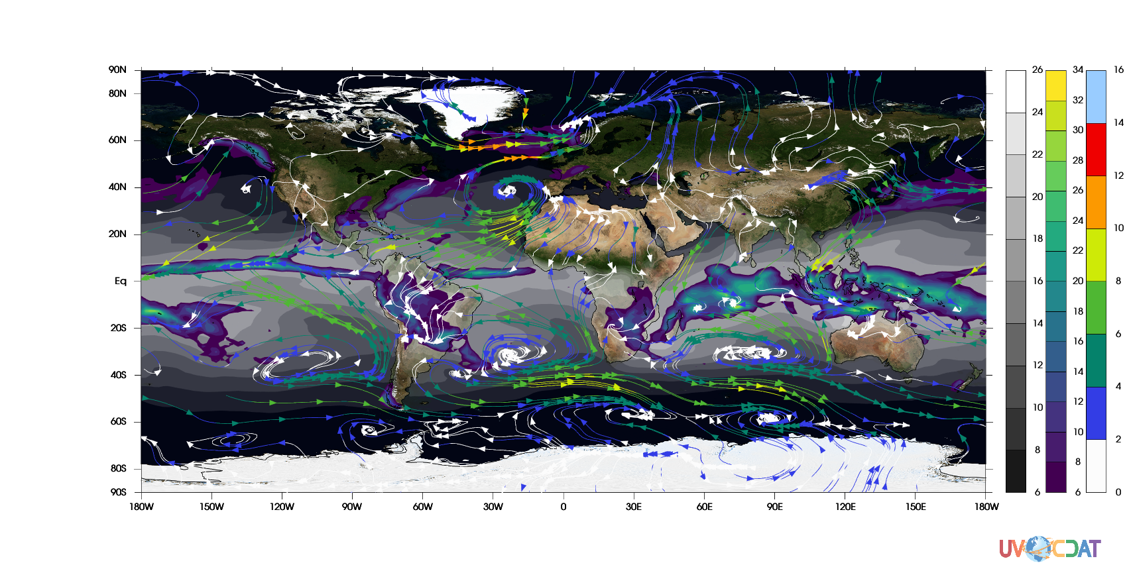
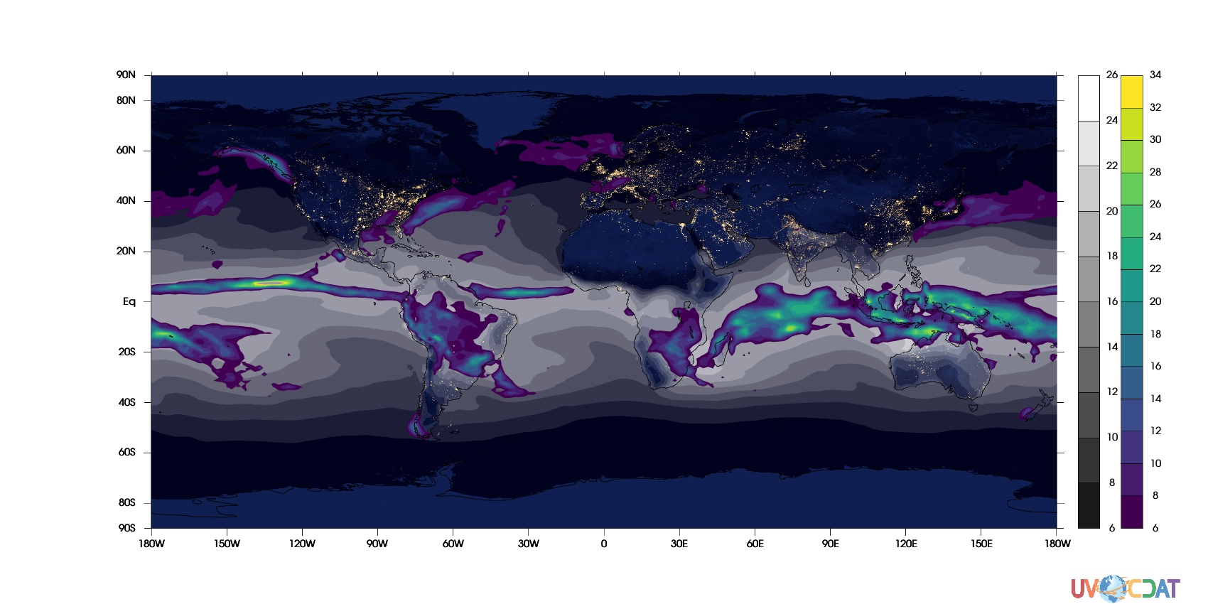
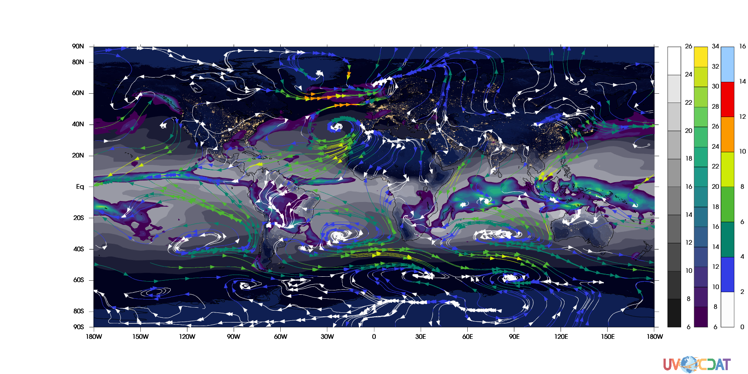
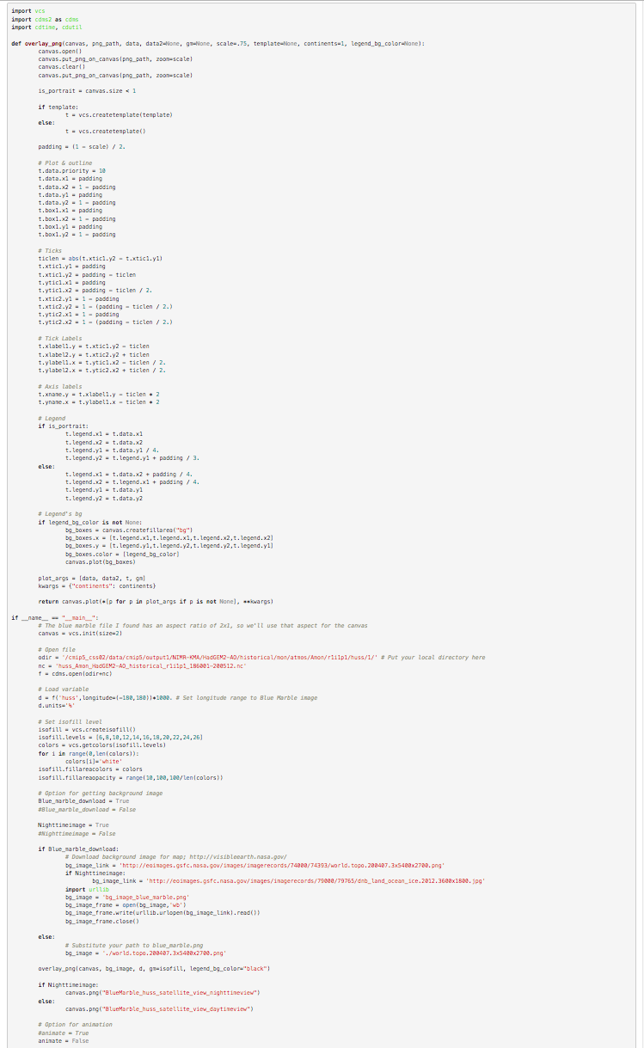
Scientific analysis examples (3)
Users can have self-describing Python source code and easily apply it to their analysis
Notes:
This is one of examples displayed in the CDAT webpage. We provide a Python code that user can download to reproduce and customize for their work. One of strengths of CDAT is the transpernecy. It enables overlaying of fields, use fancy background map.
You are looking at NASA’s blue marble image as background, adding humidity field, precipitation, and winds. Or you can use beautiful nigthview image if you want. Letting plot multiple variables together on one scene helps analysis.

Slide 11
Scientific analysis examples (4)
Highlight of the example code:
import cdms2
from eofs.cdms import Eof
#Open file
:
# Load variable
d = …
:
# EOF (take leading mode)
solver = Eof(d, weights='area')
eof = solver.eofsAsCovariance(neofs=1)
# Plot
:
https://uvcdat.llnl.gov/examples/eof_analysis_sst.html
Notes:
One of example that I’d like to highlight is “EOF analysis”. The EOF analysis is one of most frequently repeated analysis especially when investigating about internal variability such as El-Nino and La Nina, Monsoon, and modes of variability in globe. Researchers have had applied their own codes, which is not much reusable and highly optimized for their own purpose. That means someone new in such research have had to reinvent their own wheels.
The CDAT has the EOF analysis functionality, which was implemented from well-established python open-source library. While usually researchers have had spent weeks even months for reinventing wheels with hundreds lines of code to make this happen, with CDAT, you will need just two line of codes, and it can be used over and over, which are huge advantage.
I am going to revisit this eof analysis when I show the demo.

Slide 12
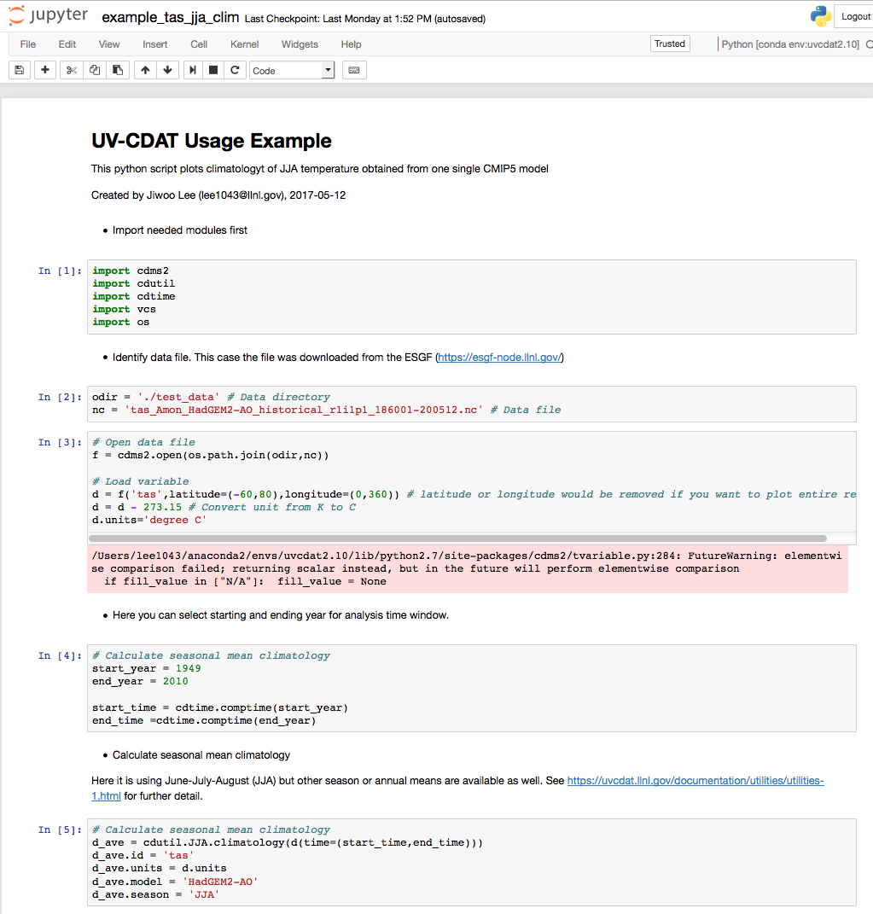
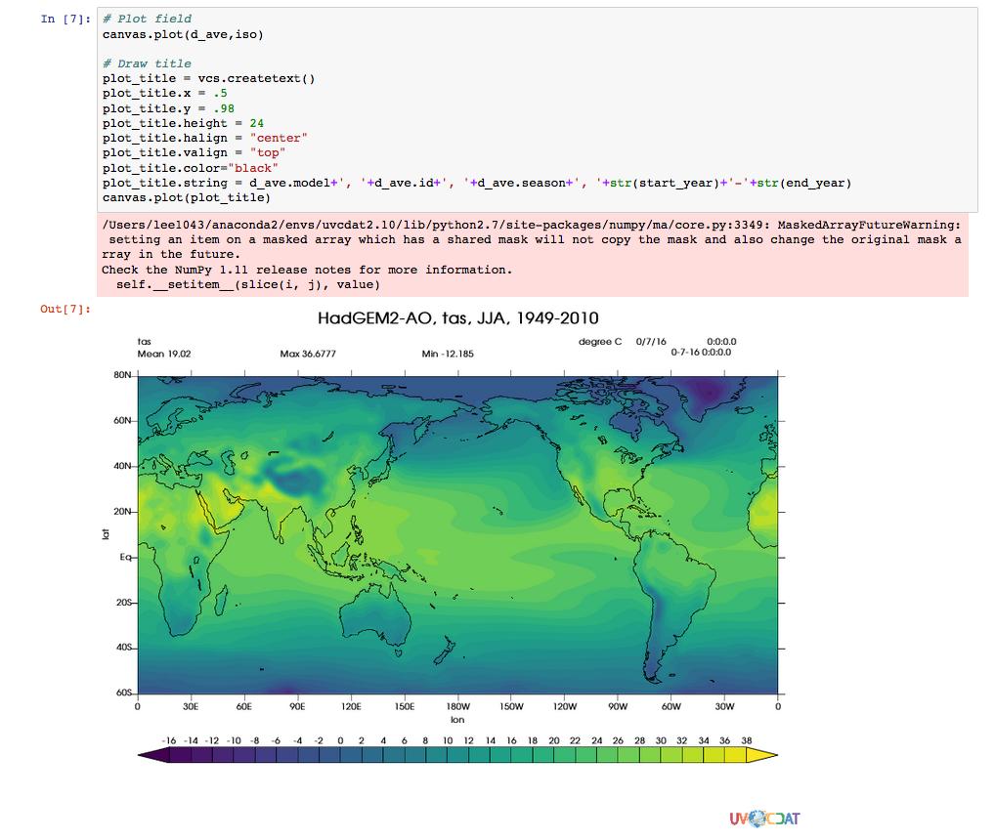
Server-side visualization for Exploratory Analysis
Jupyter Notebook Framework
Available to run on Web-browsers
Enables exploratory analysis (by implementing it on server side)
(Demo)
Notes:
This silde is for “Server-side …..”
Jupyter Notebook is cool feature that enable to run code on any web browser, and it even shows the graphical output in the browser. In other words, it is one of key tools that make server-side work available. Implementing this to ESGF node would lead user to make exploratory analysis. Probably it should be easy to catch with showing demo.

Slide 13
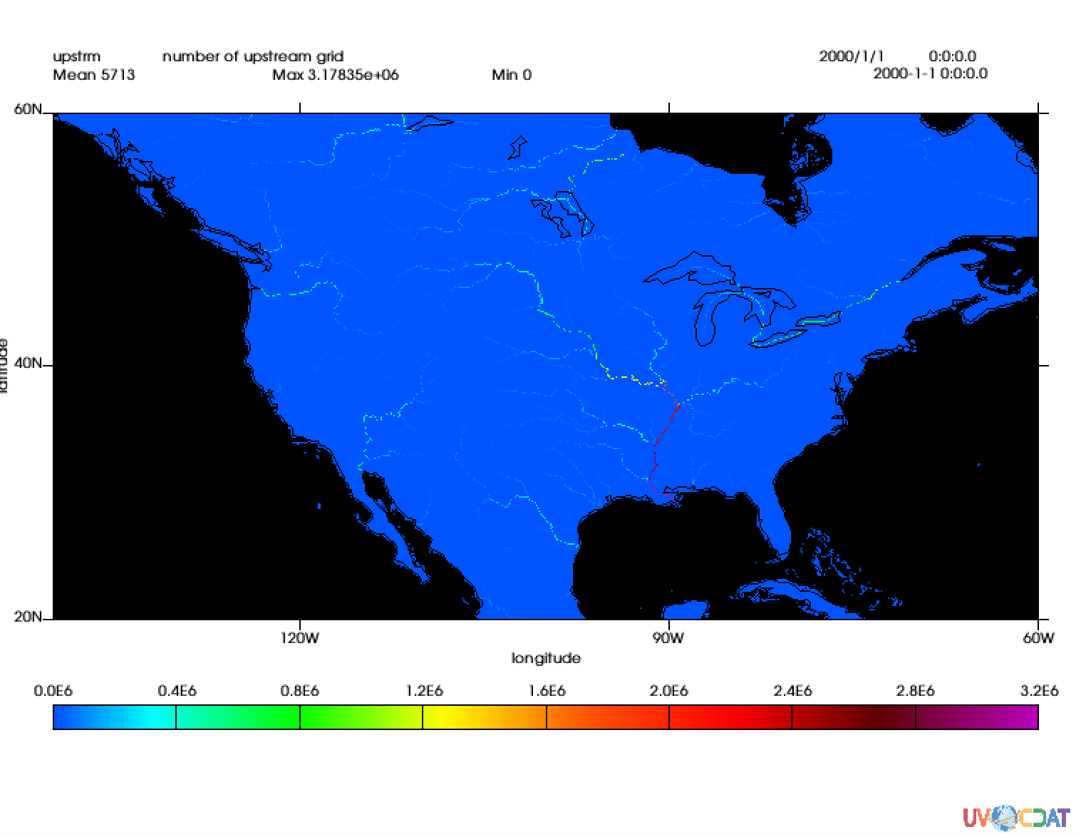
Documented examples for a diverse geoscience communities (1)
e.g., Hydrology
Data courtesy: Wu et al. (2012) A New Global River Network Database for Macroscale Hydrologic modeling, Water Resour. Res
Notes:
Last effort that I would like to emphasize is, we are working on to make our tools viral in the geoscience community, because we know this CDAT could advance analyses in diverse geoscience fields.
As first example, this plot shows CDAT application to hydrological domain. It number of upstream grid point for each river, which can be measure of how long the river is and how large its basin is. Combining this information with precipitation and runoff measures, you can discover how water cycle work.

Slide 14
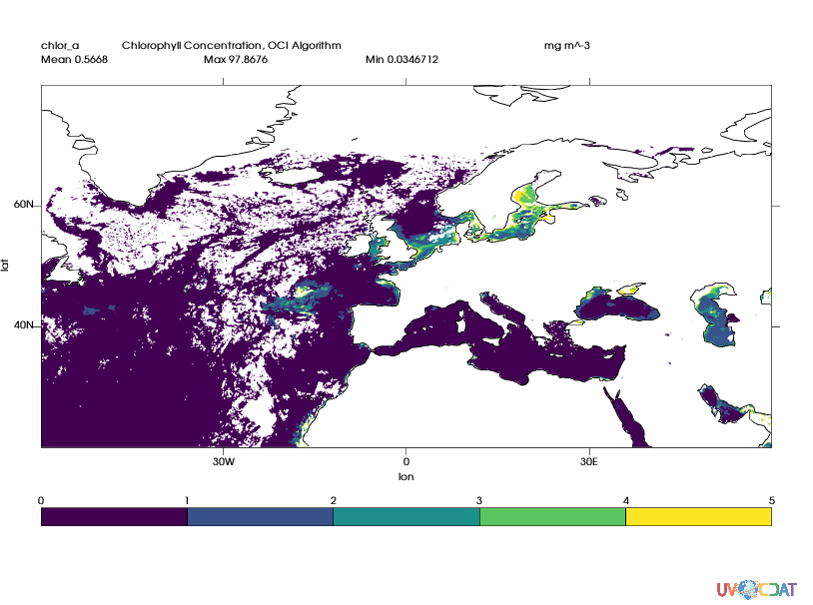
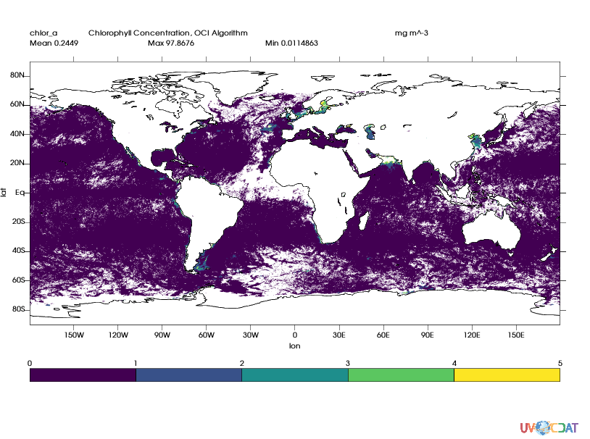
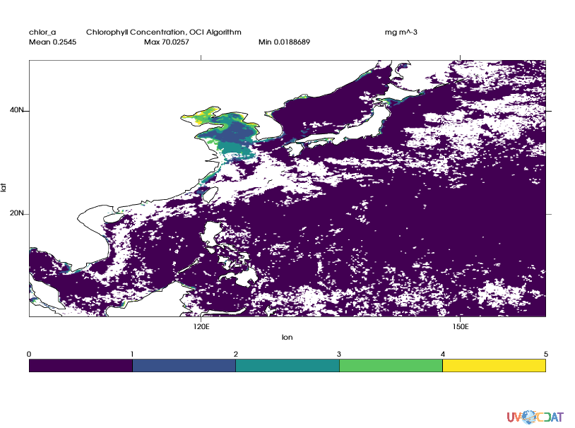
Documented examples for a diverse geoscience communities (2)
e.g., Geo-Biochemistry
Data courtesy: NASA GSFC Ocean Biology Processing Group, Ocean satellite observation (MODIS)
Notes:
Second example shows CDAT application to geo-biochemistry domain. It shows snapshot of chlorophyll concentration taken from satellite observation.

Slide 15
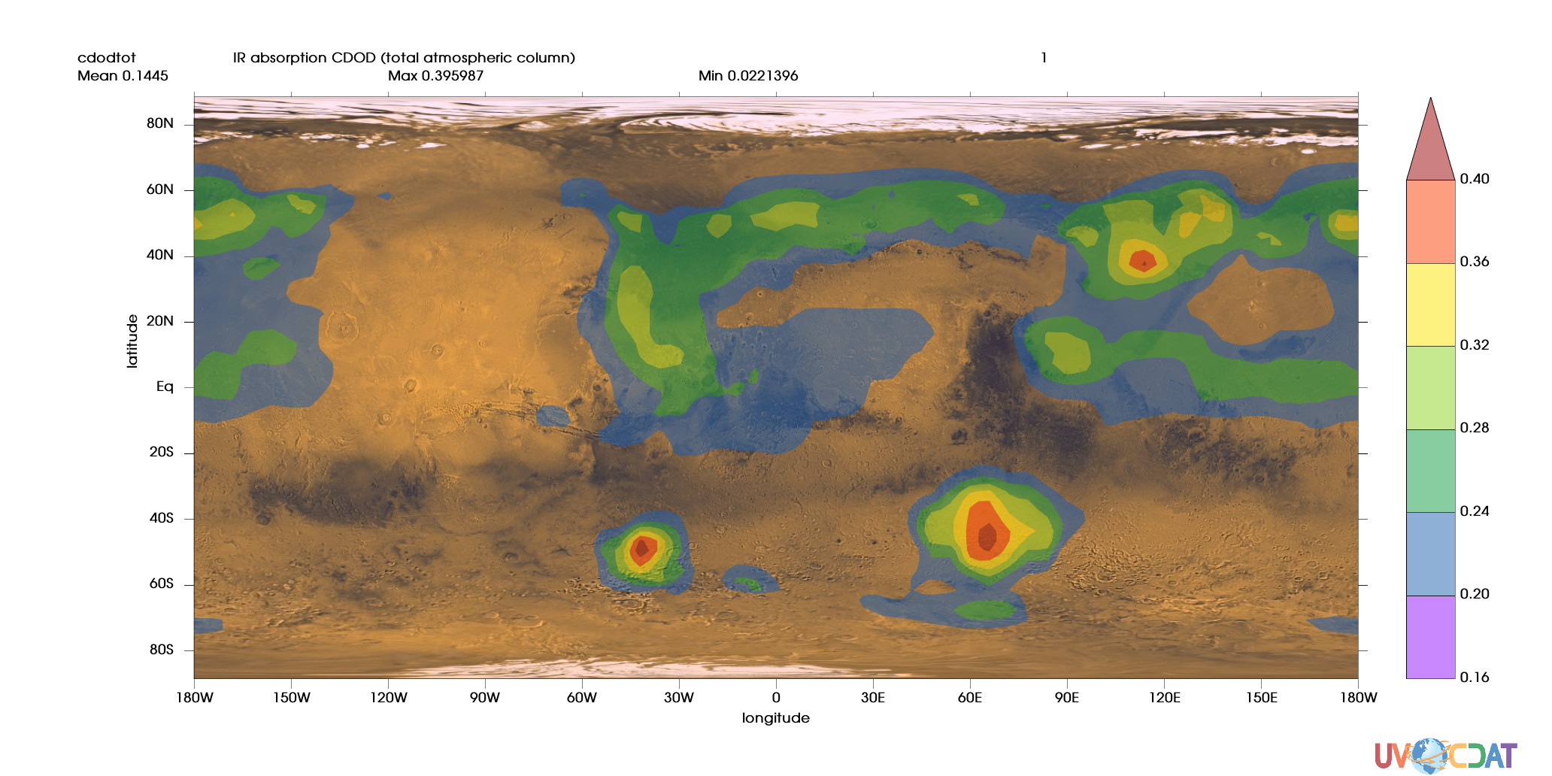
Documented examples for a diverse geoscience communities (3)
e.g., Visualization of Martian climate simulation
Courtesies:
- Data: Montabone et al.(2014) The Mars Analysis Correction Data Assimilation (MACDA) Dataset V1.0, Geo Data J
- Background image: NASA JPL and GSFC
Notes:
This plot is the example of CDAT application to astrophysics domain. It shows Infra-red radiation absorption by the Martian atmosphere, simulated by Mars model developed from UK and France. Background image was grepped from NASA JPL and GSFC’s Martian mission website.

Slide 16
Summary and future works
Development of server-side model performance metric enables 1) Exploratory analysis for Big data (climate or other models in ESGF) 2) model genealogy study and systematic error characterization → Uncertainty Quantification
We will implement various metrics and visualizations on server-side
Scientific analysis examples for frequently repeated analyses has been developed & released
We will add more examples introduced by research communities
Beyond the BER, diverse geoscience communities would take benefit of our work
We will find new capable areas where CDAT could be applied and advance the science
Notes:
So here is my summary and future works.

